Slide 1
CS-205 Data Structure and Algorithms
5. Analysis of Algorithms
Weihao Qu
Monmouth University

Slide 2
Analysis of Algorithms
The study of relationship between the running time of an algorithm with respect to the size of the input.
Characterize the algorithm’s running time as a function of the input size.
Can measure the running time of the algorithm, if the algorithm has been implemented.
There are system calls that are built into the programming languages or operating systems.
System. currentTimeMillis().
Run many experiments with varying input size.
Perform a statistical analysis that seeks to fit the best function.

Slide 3
Running Time
Most algorithms transform input objects into output objects.
The running time of an algorithm typically grows with the input size.
Average case time is often difficult to determine.
We focus on the worst case running time.
  Easier to analyze
  Crucial to applications such as games, finance and robotics

Slide 4
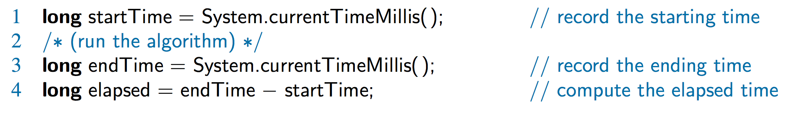
Experimental
Studies
Write a program implementing the algorithm
Run the program with inputs of varying size and composition, noting the time needed:
Plot the results

Slide 5

Limitations of Experiments
It is necessary to implement the algorithm, which may be difficult
Results may not be indicative of the running time on other inputs not included in the experiment.
In order to compare two algorithms, the same hardware and software environments must be used

Slide 6
High Level Analysis
Without running many experiments, we can analyze algorithms at a high level.
Take into account all possible inputs.
Compare the relative efficiency of any two algorithms.
Perform analysis on high-level pseudo code, and not on particular implementations.

Slide 7
Seven Important Functions
Seven functions that often appear in algorithm analysis:
  Constant ≈ 1
  Logarithmic ≈ log n
  Linear ≈ n
  N-Log-N ≈ n log n
  Quadratic ≈ n²
  Cubic ≈ n³
  Exponential ≈ 2^{n}
In a log-log chart, the slope of the line corresponds to the growth rate

Slide 8
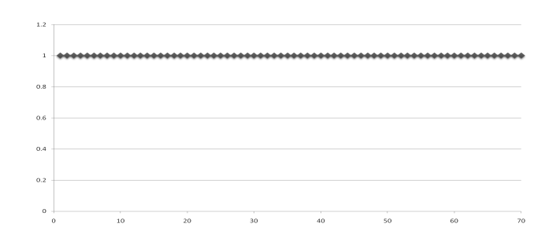
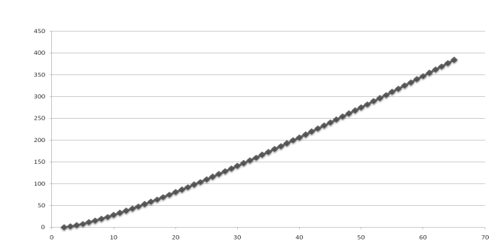
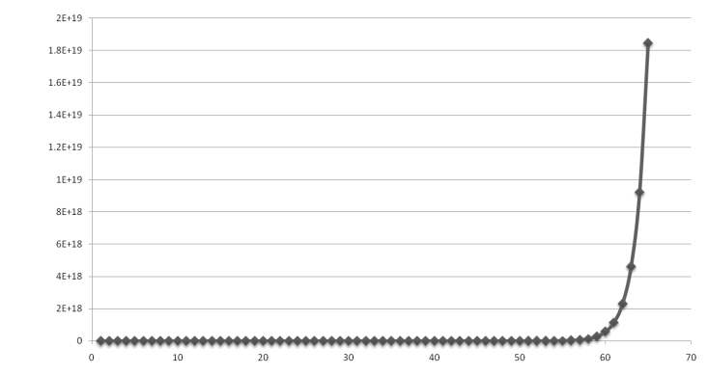
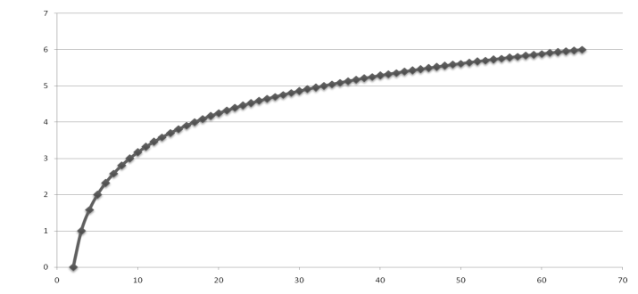
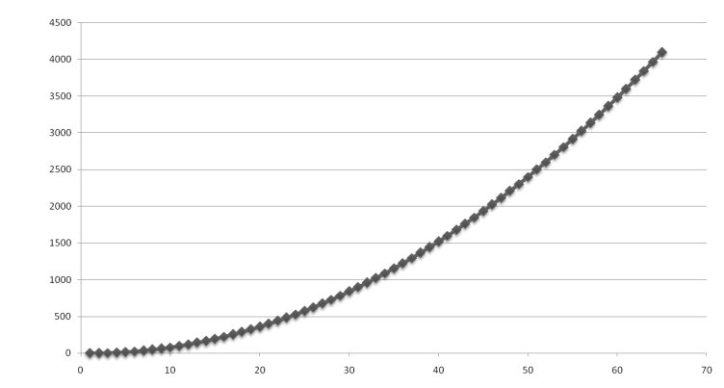
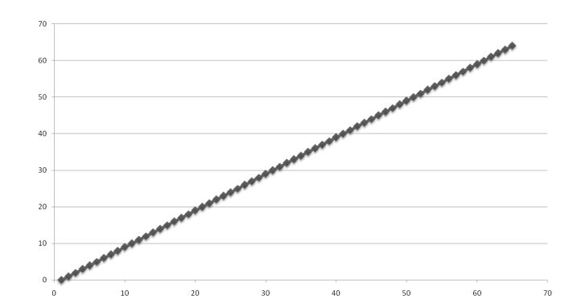
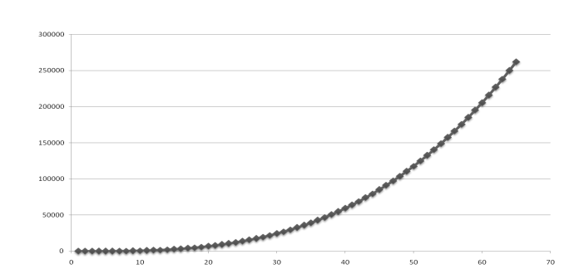
Functions Graphed
Using “Normal” Scale
g(n) = n lg n
g(n) = 1
g(n) = 2^{n}
g(n) = n²
g(n) = lg n
g(n) = n
g(n) = n³
Slide by Matt Stallmann included with permission.

Slide 9
Primitive Operations
Consider primitive operations to be low-level instructions with a constant execution time.
Thus, all we have to do is to count the number of primitive operations.
Primitive operations:
  Assign a value to a variable.
  Call a method.
  Perform an arithmetic operation.
  Compare two numbers.
  Index into an array.
  Follow an object reference.
  Return from a method.

Slide 10
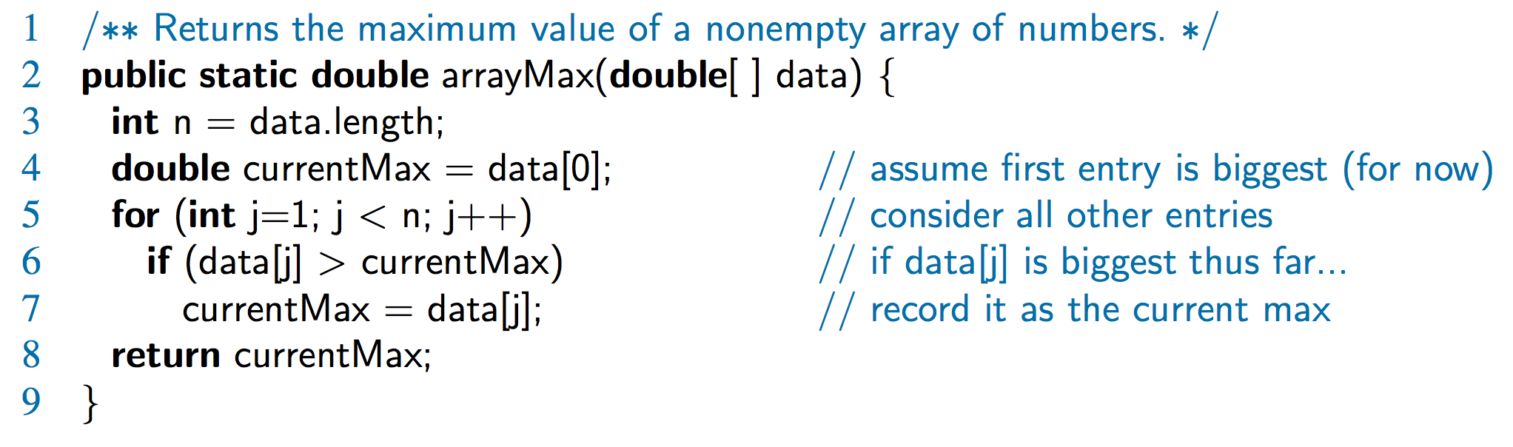
Counting Primitive Operations
By inspecting the pseudocode, we can determine the maximum number of primitive operations executed by an algorithm, as a function of the input size
Step 3: 2 ops, 4: 2 ops, 5: 2n ops,
6: 2n ops, 7: 0 to n ops, 8: 1 op

Slide 11
Estimating Running Time
Algorithm arrayMax executes 5n + 5 primitive operations in the worst case, 4n + 5 in the best case. Define:
  a = Time taken by the fastest primitive operation
  b = Time taken by the slowest primitive operation
Let T(n) be worst-case time of arrayMax. Then
a (4n + 5) ≤ T(n) ≤ b(5n + 5)
Hence, the running time T(n) is bounded by two linear functions

Slide 12
Growth Rate of Running Time
Changing the hardware/ software environment
  Affects T(n) by a constant factor, but
  Does not alter the growth rate of T(n)
The linear growth rate of the running time T(n) is an intrinsic property of algorithm arrayMax

Slide 13
Worst Case Analysis
To compute the average case, we need to compute expected running times based on a given input distribution, which means that we look at a posteriori probability distribution.
This requires a sophisticated probability theory.
Instead, we look at worst case running times.
Another advantage of a worst case is that the algorithm will do well on every input.

Slide 14
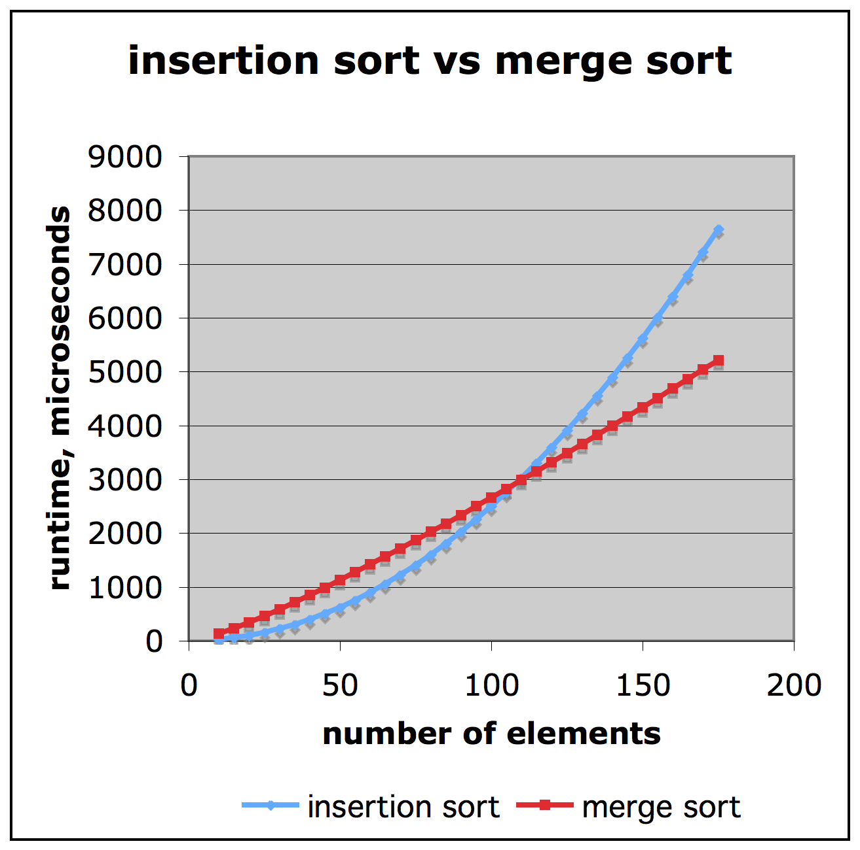
Comparison of Two Algorithms
Slide by Matt Stallmann included with permission.
insertion sort is
n² / 4
merge sort is
2 n lg n
sort a million items?
insertion sort takes
roughly 70 hours
while
merge sort takes
roughly 40 seconds
This is a slow machine, but if
100 x as fast then it’s 40 minutes
versus less than 0.5 seconds

Slide 15
Constant Factors
The growth rate is not affected by
  constant factors or
  lower-order terms
Examples
  10²n + 10⁵ is a linear function
  10⁵n² + 10⁸n is a quadratic function

Slide 16
Asymptotic Notation
We analyze algorithms written in pseudo code and estimate the number of primitive operations executed up to a constant factor.
In particular, we focus on the growth rate of the running time as a function of the input size n (a big picture approach).
The Big-Oh Notation.
  f(n) is O(g(n)) if there is a real constant c > 0 and an integer constant n₀ ≥1 such that f(n) ≤ cg(n), for n ≥ n_{0.}
This definition is referred to as the “big-Oh” notation.

Slide 17
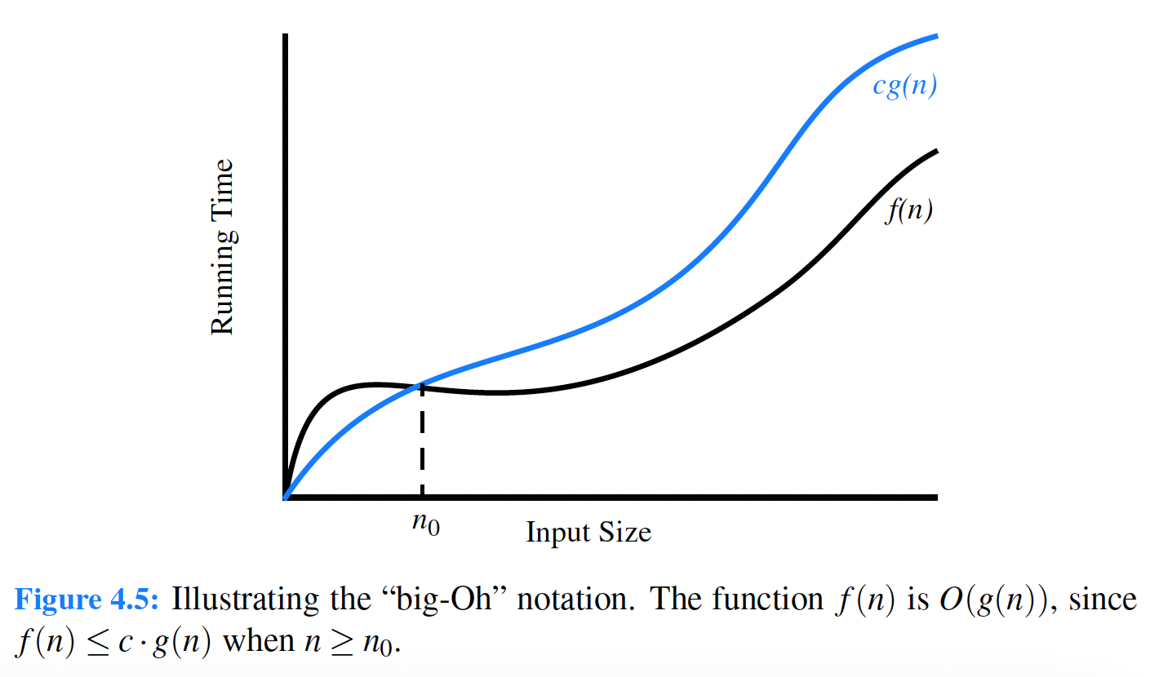
Big-Oh

Slide 18
Example
Is the function 8n – 2 O(n)?
First, we need to find a real constant c>0 and n₀ ≥1, such that 8n – 2 ≤ cn for every integer n ≥ n₀.
One choice is c = 8 and n₀ = 1
Any real number c ≥ 8 and n₀ = 1 will work.
This big-Oh is asymptotic because f(n) ≤ g(n) as n grows to infinity.
This relationship holds to a constant factor n ≥ n₀.

Slide 19
Example
Write an algorithm that computes the maximum value in an array.
What is the big-Oh of this algorithm?
Simplifications in the big-Oh notation
  ignore constant factors and lower order terms in the big-Oh natation.
For example, consider the following polynomial:
5n⁴ +3n³ + 2n² +4n + 1 ≤ (5 + 3 +2 +4 +1)n⁴ = cn⁴
for c = 15 when n ≥ n₀ = 1.
So we can conclude the polynomial to be O(n⁴) ignoring the other details.

Slide 20
Polynomials
In fact, we can generalize the growth of any polynomial function.
If f(n) is a polynomial of degree d, i.e.
f(n) = a₀ + a₁ n + … + a_{d}n^{d}
and a_{d} > 0,
then f(n) is O(n^{d}).
Prove that the above is true.
Prove that 5n² + 3nlogn + 2n + 5 is o(n²).
Prove that 3logn + 2 is O(logn)
Prove that 2^{n+2} is O(2^{n})
Prove that 2n + 100 logn is O(n)

Slide 21
Analysis Tools
We discuss the seven most important functions to analyze algorithms.
(1) The constant function.
f(n) = c
where c is some constant.
  The value of c does not vary, regardless of the value of n.
  The most fundamental constant function is g(n) = 1.
  All other constants c can be viewed as c times g(n), i.e.
  f(n) =cg(n)

Slide 22
Logarithmic Function
(2) The Logarithmic Function.
f(n) = log_{b}n, for some constant b > 1
  x = log_{b}n if and only if b^{x} = n.
  By convention, we assume a log of base 2.
  logn =log₂n

Slide 23
Logarithmic Rules
Assume real number a > 0, b > 1, c > 0, d > 1 below.
  log_{b}ac = log_{b}a + log_{b}c
  log_{b}(a/c) =log_{b}a – log_{b}c
  log_{b}a^{c} = clog_{b}a
Notation: log^{c}n to denote (logn)^{c}

Slide 24
Linear Function
(3) The linear function f(n) = n
  Time proportion to the number of elements
  For example, going through an array of n elements, requires n comparisons.
  This is the best running time to process a collection of n objects outside of the computer memory (read in n objects).

Slide 25
N-Log-N Function
(4) The n-log-n function f(n) = nlogn
  n times logn.
  This class of algorithms takes a little longer than the linear function, but a lot faster then the quadratic function.

Slide 26
Quadratic Function
(5) The quadratic function f(n) = n² = n*n
  Quadratic function appear in nested loops: the outer loop has n elements and the inner loop has n elements.
  Quadratic function occur in nested loops where the operations inside the nested loop increases monotonically.
  1 + 2 + 3 + … + (n - 2) + (n - 1) + n
  For any integer n ≥ 1,
  1 + 2 + 3…+ (n - 2) + (n - 1) + n = n(n + 1)/2

Slide 27
Other Polynomials
(6) The cubic function f(n) = n³.
  Polynomials.
  Polynomials are functions of the form:
  f(n) = a₀ + a₁n + a₂n² + a₃n³ + a₃n³ + … + a_{d}n^{d}, where a₀, a₁, …a_{d} are coefficients (constants) of the polynomial and a_{d} ≠ 0.
  The degree of the Polynomial is d, the coefficient of the highest power in the polynomials.

Slide 28
Exponential Function
(7) The exponential function f(n) = b^{n}
  Where b is a positive constant called the base and n is the exponent.
  Some transformation rules.
  (bª )^{c} =b^{ac}
  bªb^{c} = b^{a+c}
  bª/b^{c} = b^{a-c}
Example: Geometric sums
  For any integer n ≥ 0, a > 0 and a ≠ 1, Σ^{n}_{i=0} a^{i} = 1 + a + a² + … + a^{n}
  Equals (a^{n+1} – 1)/ (a - 1)
  Thus, 1 + 2 +…+ 2^{n-1} = 2^{n} - 1

Slide 29
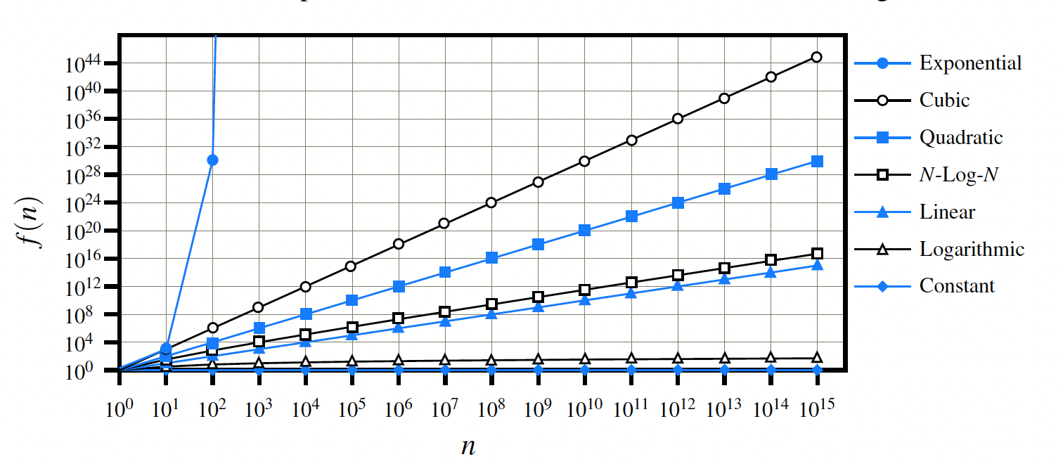
Growth Rates
The growth rates of the classes of functions.
  constant: 1
  logarithm: logn
  linear: n
  n-log-n: nlogn
  quadratic: n²
  cubic: n³
  exponential: d^{n}

Slide 30
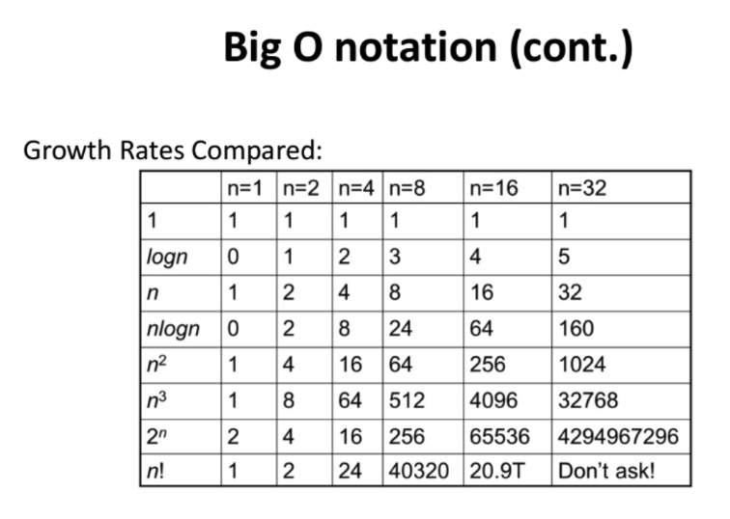
Growth Rates
The growth rates of the classes of functions.
  constant: 1
  logarithm: logn
  linear: n
  n-log-n: nlogn
  quadratic: n²
  cubic: n³
  exponential: d^{n}

Slide 31
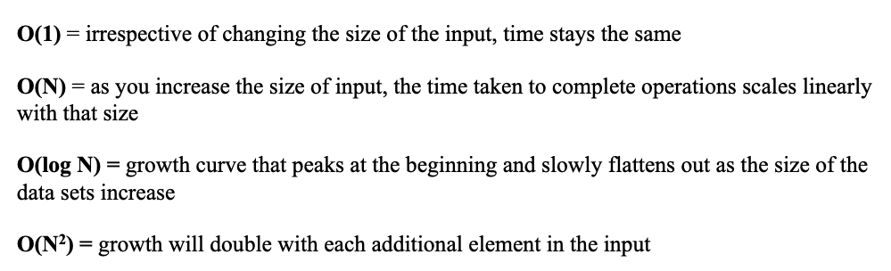
Growth Rates

Slide 32
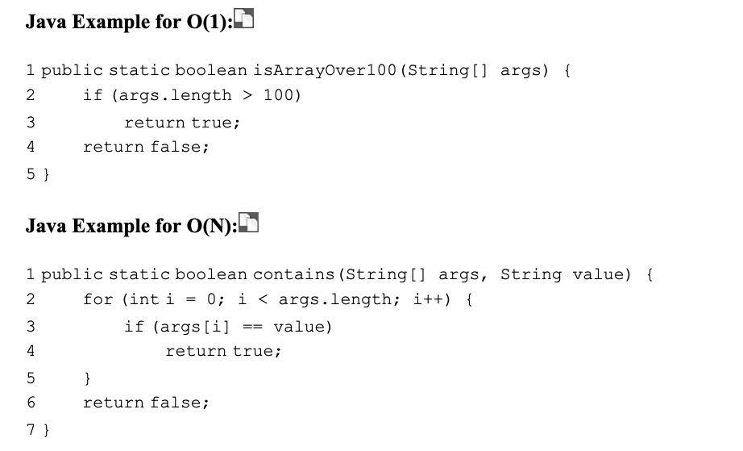
Growth Rates

Slide 33
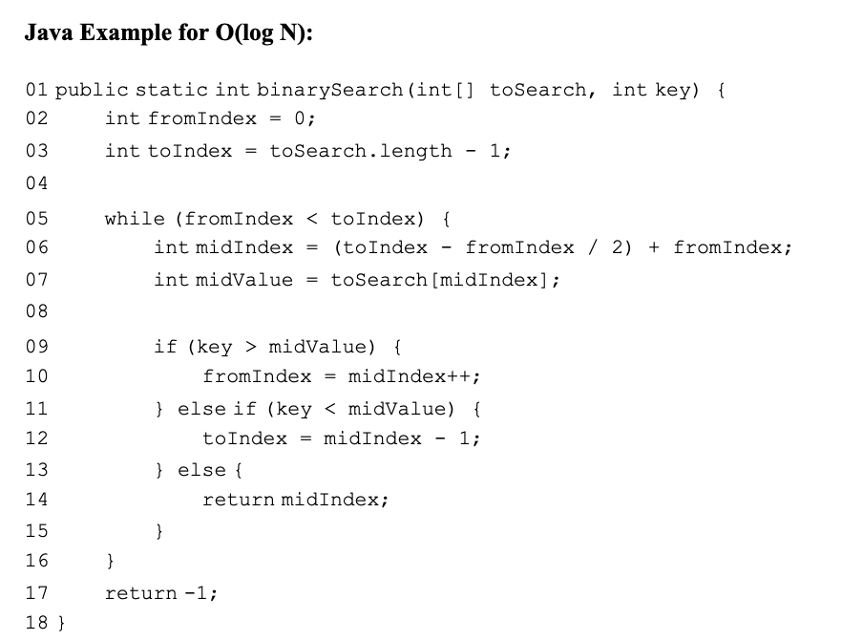
Growth Rates

Slide 34
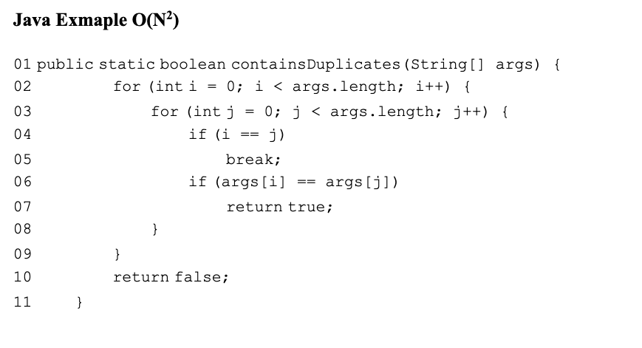
Growth Rates

Slide 35
More Big-Oh Examples
7n - 2
  7n-2 is O(n)
  need c > 0 and n₀ ≥ 1 such that 7 n - 2 ≤ c n for n ≥ n₀
  this is true for c = 7 and n₀ = 1
3 n³ + 20 n² + 5
  3 n³ + 20 n² + 5 is O(n³)
  need c > 0 and n₀ ≥ 1 such that 3 n³ + 20 n² + 5 ≤ c n³ for n ≥ n₀
  this is true for c = 4 and n₀ = 21
3 log n + 5
  3 log n + 5 is O(log n)
  need c > 0 and n₀ ≥ 1 such that 3 log n + 5 ≤ c log n for n ≥ n₀
  this is true for c = 8 and n₀ = 2

Slide 36
Big-Oh and Growth Rate
The big-Oh notation gives an upper bound on the growth rate of a function
The statement “f(n) is O(g(n))” means that the growth rate of f(n) is no more than the growth rate of g(n)
We can use the big-Oh notation to rank functions according to their growth rate
 | f(n) is O(g(n)) | g(n) is O(f(n))
g(n) grows more | Yes | No
f(n) grows more | No | Yes
Same growth | Yes | Yes

Slide 37
Big-Oh Rules
If is f(n) a polynomial of degree d, then f(n) is O(n^{d}), i.e.,
  Drop lower-order terms
  Drop constant factors
Use the smallest possible class of functions
  Say “2n is O(n)” instead of “2n is O(n²)”
Use the simplest expression of the class
  Say “3n + 5 is O(n)” instead of “3n + 5 is O(3n)”

Slide 38
Asymptotic Algorithm Analysis
The asymptotic analysis of an algorithm determines the running time in big-Oh notation
To perform the asymptotic analysis
  We find the worst-case number of primitive operations executed as a function of the input size
  We express this function with big-Oh notation
Example:
  We say that algorithm arrayMax “runs in O(n) time”
Since constant factors and lower-order terms are eventually dropped anyhow, we can disregard them when counting primitive operations

Slide 39
Computing Prefix Averages
We further illustrate asymptotic analysis with two algorithms for prefix averages
The i-th prefix average of an array X is average of the first (i + 1) elements of X:
A[i] = (X[0] + X[1] + … + X[i])/(i+1)
Computing the array A of prefix averages of another array X has applications to financial analysis

Slide 40
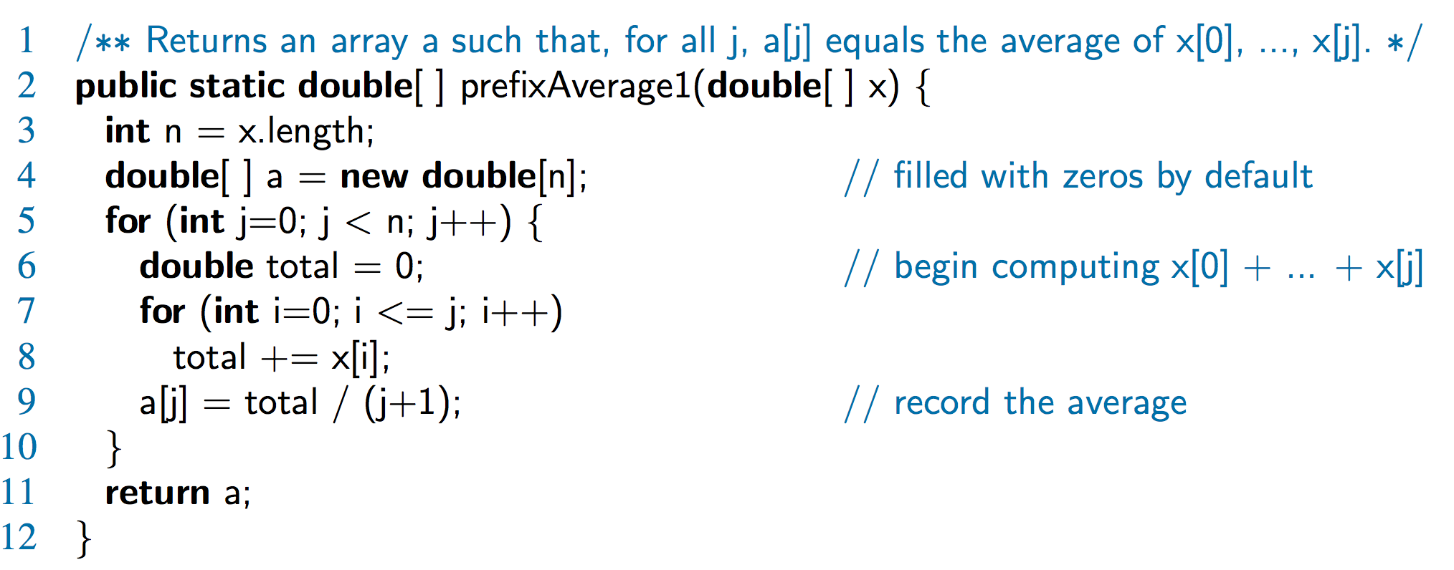
Prefix Averages (Quadratic)
The following algorithm computes prefix averages in quadratic time by applying the definition

Slide 41
Arithmetic Progression
The running time of prefixAverage1 is
O(1 + 2 + …+ n)
The sum of the first n integers is n(n + 1) / 2
  There is a simple visual proof of this fact
Thus, algorithm prefixAverage1 runs in O(n²) time

Slide 42
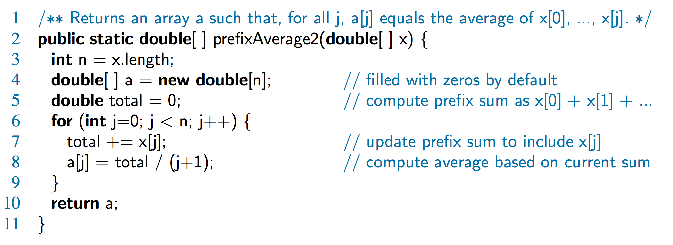
Prefix Averages 2 (Linear)
The following algorithm uses a running summation to improve the efficiency
Algorithm prefixAverage2 runs in O(n) time!

Slide 43
Math you need to Review
Summations
Powers
Logarithms
Proof techniques
Basic probability
Properties of powers:
  a^{(b+c)} = a^{b}a ^{c}
  a^{bc} = (a^{b})^{c}
  a^{b} /a^{c} = a^{(b-c)}
  b = a ^{log}_{a}^{b}
  b^{c} = a ^{c*log}_{a}^{b}
Properties of logarithms:
  log_{b}(xy) = log_{b}x + log_{b}y
  log_{b} (x/y) = log_{b}x - log_{b}y
  log_{b}xa = alog_{b}x
  log_{b}a = log_{x}a/log_{x}b

Slide 44
Relatives of Big-Oh
big-Omega
  f(n) is Ω(g(n)) if there is a constant c > 0
  and an integer constant n₀ ≥ 1 such that
  f(n) ≥ c g(n) for n ≥ n₀
big-Theta
  f(n) is Θ(g(n)) if there are constants c’ > 0 and c’’ > 0 and an integer constant n₀ ≥ 1 such that
  c’g(n) ≤ f(n) ≤ c’’g(n) for n ≥ n₀

Slide 45
Intuition for Asymptotic Notation
big-Oh
  f(n) is O(g(n)) if f(n) is asymptotically less than or equal to g(n)
big-Omega
  f(n) is Ω(g(n)) if f(n) is asymptotically greater than or equal to g(n)
big-Theta
  f(n) is Θ(g(n)) if f(n) is asymptotically equal to g(n)

Slide 46
Example Uses of the Relatives of Big-Oh
5n² is Ω(n²)
  f(n) is Ω(g(n)) if there is a constant c > 0 and an integer constant n₀ ≥ 1 such that f(n) ≥ c g(n) for n ≥ n₀
  let c = 5 and n₀ = 1
5n² is Ω(n)
  f(n) is Ω(g(n)) if there is a constant c > 0 and an integer constant n₀ ≥ 1 such that f(n) ≥ c g(n) for n ≥ n₀
  let c = 1 and n₀ = 1
5n² is Θ(n²)
  f(n) is Θ(g(n)) if it is Ω(n²) and O(n²). We have already seen the former, for the latter recall that f(n) is O(g(n)) if there is a constant c > 0 and an integer constant n₀ ≥ 1 such that f(n) < c g(n) for n ≥ n₀
  Let c = 5 and n₀ = 1

Slide 47
Exercises
Page 182-183
R-4.16

Slide 48
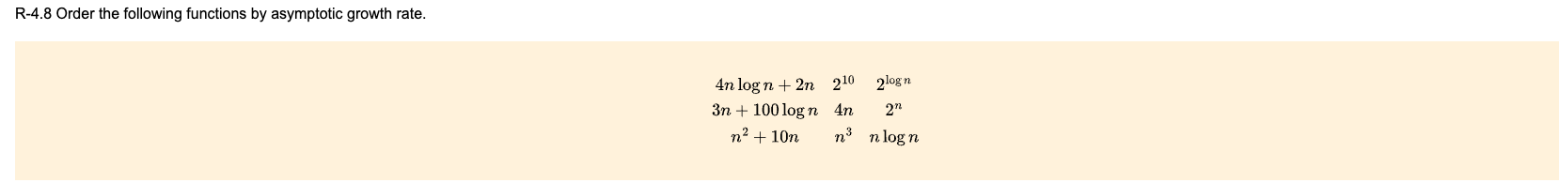
Exercises
Page 182-183
R-4.16

Slide 49
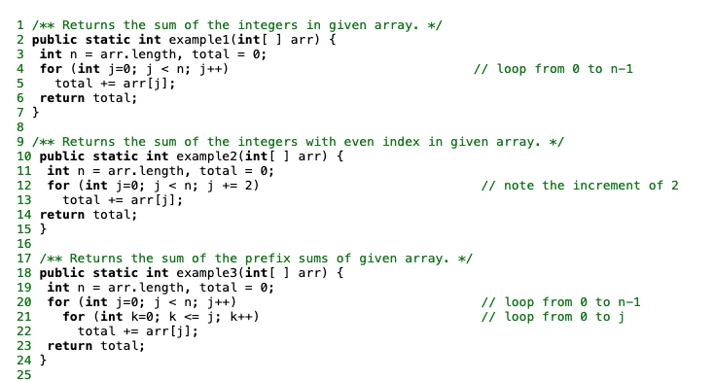
Exercises
Page 182-183
R-4.16

Slide 50
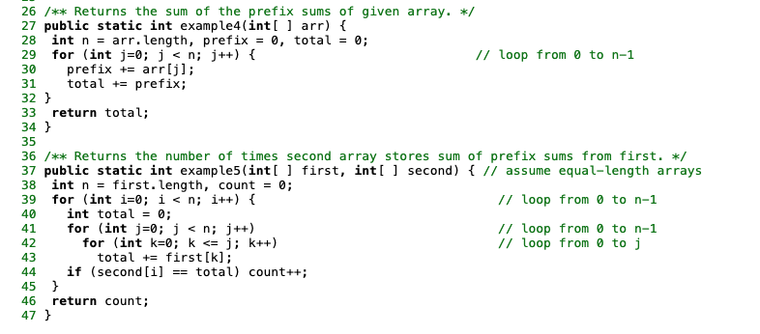
Exercises
Page 182-183
R-4.16

Slide 51
Exercises
Page 182-183
R-4.16

